Slide 1
Norms and Trust: Exploring Poverty’s Roots in U.S. Communities
Cristina Bicchieri
Daniel Putman, Masoud Movahed, Kevin Vallier

Slide 2
Agenda
The Role of Social Norms in Poverty
Norms Measurement
Norms Results: Education and Welfare
Dimensions of Trust
Conditionality of Behavioral Trust on Social Expectations

Slide 3
Norms and Poverty
Norms emerge under conditions of scarcity.
These norms influence behaviors that either further entrench poverty, or allow individuals to escape poverty.
We study norms on education, welfare, violence

Slide 4
The Role of Norms
Social norms are behavioral rules that apply to sets of situations (Bicchieri 2006, 2016).
Conditions for the existence of a norm in population P:
Individuals in P know that the rule applies in specific situations
They expect others in the reference network to follow the rule (empirical expectations)
They expect others in their reference network to believe the rule should be followed and disapprove of non-compliance (normative expectations)
They prefer to follow the rule if they hold empirical and normative expectations (conditional preferences)

Slide 5
Types of Behavior
 | Independent Behavior (Unconditional Preferences) | Interdependent Behavior (Conditional Preferences)
Descriptive | Custom | Descriptive Norm
 | You prefer to do X because you believe X meets your needs | You prefer to do X because you expect others to do X (empirical expectations)
 | Your choice does not depend on others doing X or thinking that you should do X | Your choice depends on your empirical expectations of others' behavior
Injunctive | Moral Rule | Social Norm
 | You prefer to do X because you believe X is the right thing to do | You prefer to do X because you expect others to do X (empirical expectations) and you believe that others think that you should do X (normative expectations)
 | Your choice does not depend on others doing X (empirical expectations) or others thinking that you should do X (normative expectations) | Your choice depends on both empirical and normative expectations

Slide 6
Types of Norms
A Descriptive Norm is a... | A Social Norm is a...
Pattern of behavior such that | Rule of behavior such that
individuals prefer to conform to it on condition that | individuals prefer to conform to it on condition that
they believe most people in their reference network conform to it (empirical expectations) | they believe most people in their reference network conform to it (empirical expectations) and most people in their reference network believe they ought to conform to it (normative expectations)

Slide 7
Overview of Norm Diagnosis
We undertake norm diagnosis in two stages:
Measure the relation between actual empirical and normative expectations and the behavior.
Use hypothetical vignettes to explore the causal relation between social expectations and behavior.

Slide 8
Norms Diagnosis: Measure Actual Social Expectations
Are actual empirical and/or normative expectations significantly and positively associated with the measured behavior?
For a given behavior x, we elicit the following:
Respondent’s own engagement in behavior x.
“Out of 10 people that are important to you, how many engage in behavior x?” (Empirical expectations)
“Out of 10 people that are important to you, how many approve of behavior x?” (Normative expectations)

Slide 9
Norms Diagnosis: Measure Actual Social Expectations
We check for significant and positive association between the respondent engaging in a behavior, and empirical and normative expectations of the behavior.
This tells us if the behavior is associated with social expectations. However, we cannot identify the direction of causality between expectations and behavior due to selection bias. To establish causality, we use vignettes.

Slide 10
Norms Diagnosis: 2x2 Vignettes
Respondents are randomly assigned to one of four social expectation conditions
"Imagine a person who is similar to you in age, income, gender and race. This person just moved to a new community and learns that..."
 | Low Normative | High Normative
Low Empirical | "few people do X and few people approve of doing X” | "few people do X and many people approve of doing X"
High Empirical | "many people do X and few people approve of doing X" | "many people do X and many people approve of doing X"
"How likely is it that this person will do X?”
- Extremely Likely
- Likely
- Unlikely
- Extremely Unlikely

Slide 11
Norms Diagnosis: Vignettes
We use hypothetical characters because
(a) people have difficulty imagining themselves in counterfactual situations, and
(b) using a hypothetical individual avoids social desirability bias in responses
Respondents' reactions to hypothetical characters reflect their own likely behavior

Slide 12
Norms Diagnosis: Vignettes
We estimate aggregate differences in predicted behavioral outcomes between social expectation conditions. We look for:
Significant differences between high empirical and normative, and low empirical and normative expectation conditions. That is, is the behavior dependent on social expectations?
If yes, we look for:
Significant differences between high empirical and low normative, and low empirical and low normative conditions. That is, is the behavior dependent on empirical expectations?
Significant differences between low empirical and high normative, and low empirical and low normative conditions. That is, is the behavior dependent on normative expectations?
If yes to both, we estimate whether behavior is more dependent on empirical or normative expectations - is the norm empirically or normatively led?

Slide 13
Norms Diagnosis: Vignettes
We diagnose behaviors as follows:
If the predicted behavior is, on average:
Not dependent on any social expectations: No norm exists
Dependent only on empirical expectations: Descriptive norm
Dependent on both empirical and normative expectations: Social norm

Slide 14
Norms Diagnosis: Vignettes
Test 1: Is the behavior interdependent? That is, is the likelihood of behavior significantly greater between low empirical and normative, and high empirical and normative conditions?
Test 2: Do empirical expectations matter? That is, is the likelihood of behavior significantly greater between low empirical and normative, and high empirical and low normative conditions?
Test 3: Do normative expectations matter? That is, is the likelihood of behavior significantly greater between low empirical and normative, and low empirical and high normative conditions?

Slide 15
Norms Diagnosis: Vignettes
If both empirical and normative expectations matter, we evaluate whether the social norm is empirically or normatively led.
If the resulting significance > 0, the social norm is empirically led.
If the resulting significance < 0, the social norm is normatively led.
If the resulting significance = 0, the social norm is balanced.

Slide 16
Norms Diagnosis: High School Dropout
We first evaluate the relationship between behavior and actual social expectations.
We elicit:
Respondent’s own high school dropout behavior (yes/no).
“Out of 10 people that were important to you in high school, how many dropped out of high school?” (Empirical expectations)
“Out of 10 people that were important to you in high school, how many approved of dropping out of high school?” (Normative expectations)

Slide 17
Norms Diagnosis: High School Dropout
We find significant and positive associations between the prevalence and approval of dropping out in one’s reference network, and the respondent’s likelihood of dropping out. However, we cannot establish causality between social expectations and the behavior without a vignette experiment.
"Imagine a person who is similar to you in age, income, gender and race. This person just moved to a new community and learns that..."
 | Low Normative | High Normative
Low Empirical | "few people drop out of high school and few people approve of dropping out of high school" | "few people drop out of high school and many people approve of dropping out of high school"
High Empirical | "many people drop out of high school and few people approve of dropping out of high school" | "many people drop out of high school and many people approve of dropping out of high school"
"How likely is it that this person will drop out of high school?
- Extremely Likely
- Likely
- Unlikely
- Extremely Unlikely

Slide 18
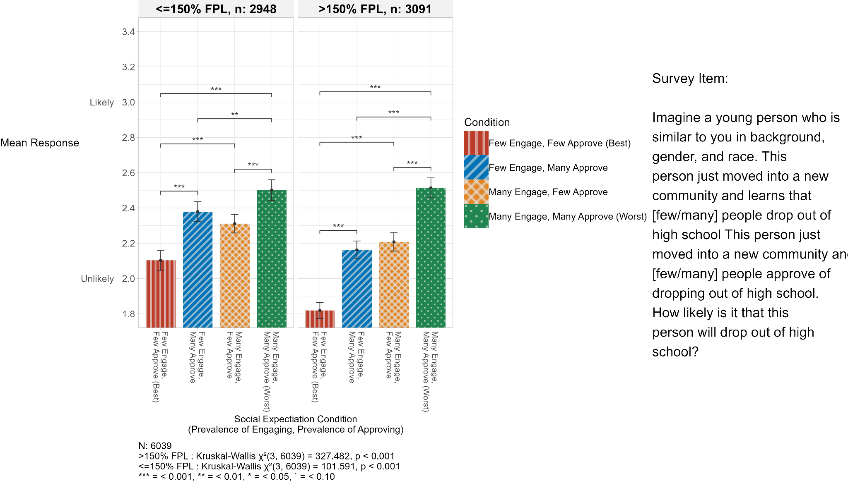
Norms Diagnosis: High School Dropout
Aggregating across conditions, we find that dropping out of high school is dependent on:
Social expectations:
Empirical expectations, and
Normative expectations.
Thus, in both poor and non-poor communities, the behavior of dropping out of high school is influenced by a social norm.

Slide 19
Norms Results Summary
We find that the following behaviors are influenced by empirically led social norms:
Pursuing higher education
Dropping out of high school
Applying for welfare
Embarrassment when applying for welfare
Responding to disrespect with violence

Slide 20
From Norms to Trust
We further explore the causal relationship between social expectations in disordered environments (littering, stealing and violent environments), and trusting behaviors:
Is the environment good or not?
Are trusting behaviors conditional on social expectations about the environment?

Slide 21
Behavioral Trust
Using a behavioral trust framework (Person A trusts Person B to do Action X in Context Y), we measure the conditionality of trusting behaviors on social expectations about stealing, littering, and violent environments

Slide 22
Behavioral Trust and Norms
Behavioral Trust Framework
Norms as Cognitive Proxies
A trusts B to do X in Context Y
To measure trusting behaviors, we must specify B, X and Context Y
Does A know B? If not, what is a cognitive proxy?
In Context Y, what is commonly done and expected?
Assume B is representative of the social context Y
If social expectations and conditional preferences exist, the good/bad social context is regulated by norms.
Do such norms influence trust?

Slide 23
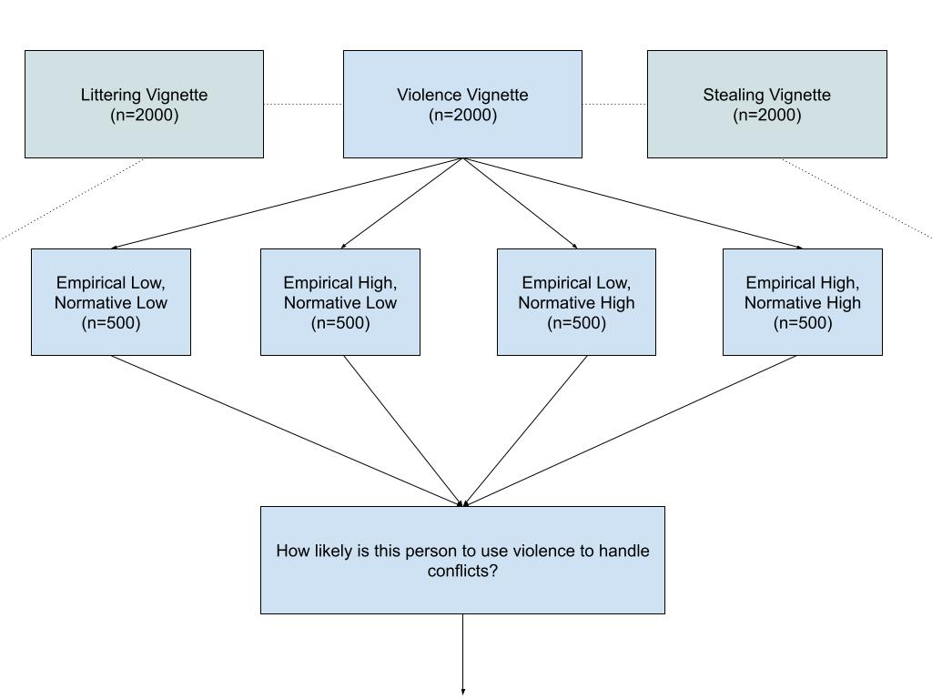
2-step Vignette

Slide 24
Example: Stealing
“Imagine a person who is similar to you in age, income, gender, and race. This person just moved into a new community and learns that in this community, many people steal from the local grocery store and few people think it’s okay to steal from the local grocery store.
In this scenario, how likely is it that this person will:
Lend their phone to a stranger for a call?
Expect the return of a favor from a community member?
Expect the return of a lost wallet containing money and contact information?
Receive truthful information about auto repair costs from a mechanic in the community?”

Slide 25
Stealing-Trust Results Summary: Poverty Status
Stratifying by poverty status, we find the following.
For both poor and non-poor respondents, trusting behaviors are all influenced by social norms. These norms are balanced among poor respondents, and empirically led among non-poor respondents

Slide 26
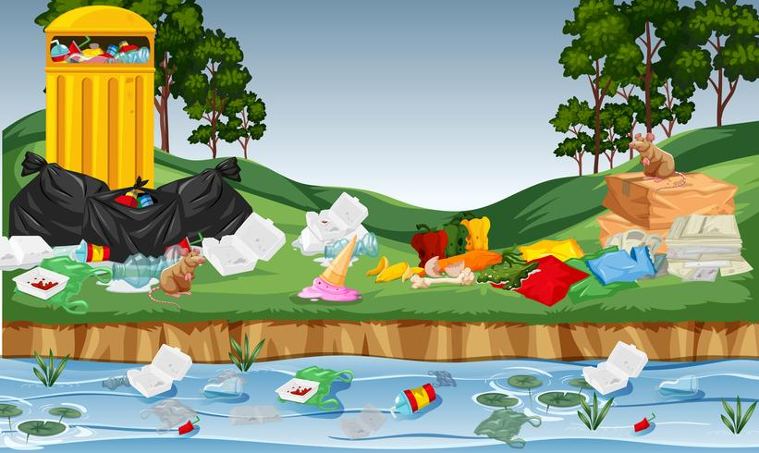
Littering-Trust Results Summary: Poverty Status
Stratifying by poverty status, we find the following:
For non-poor respondents, most trusting behaviors are influenced by empirically-led or balanced social norms
For poor respondents, two trusting behaviors (lending a phone and expecting a favor to be returned) are not interdependent behaviors. Two trusting behaviors (expecting a wallet to be returned and trusting a mechanic for truthful cost estimates) are interdependent behaviors

Slide 27
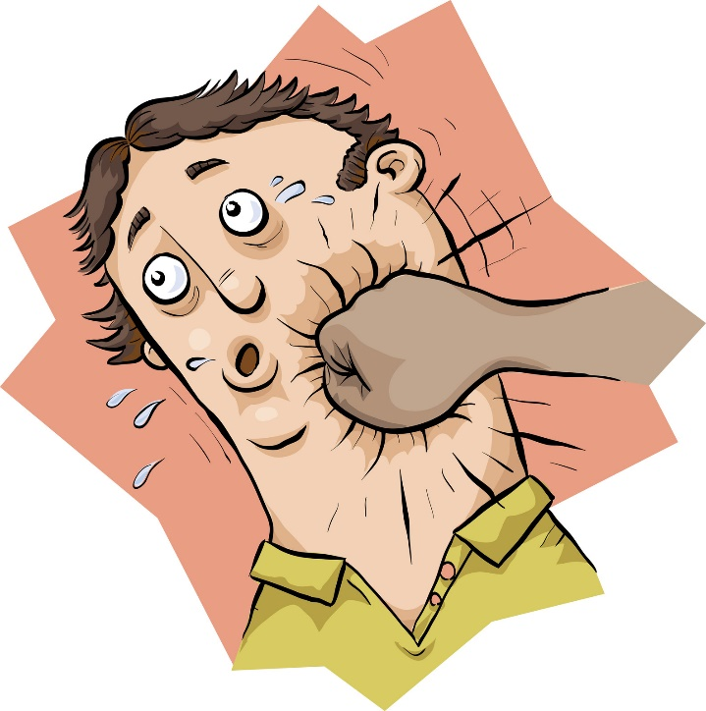
Violence-Trust Results Summary: Poverty Status
Stratifying by poverty status, we find the following.
For non-poor respondents, trusting behaviors are largely influenced by empirically-led social norms
For poor respondents, trusting behaviors are influenced by descriptive norms - empirical expectations but not normative expectations ones play a role in the predicted likelihood of behavior

Slide 28
Stealing-Trust Results Summary: Race/Ethnicity
Stratifying by race/ethnicity, we find the following.
For White respondents, trusting behaviors are influenced by social norms. These norms are balanced (believing a favor would be returned and believing a mechanic would be truthful) or empirically led (lending a phone and believing a wallet would be returned)
For Black respondents, trusting behaviors are not interdependent behaviors. Trust does not fall as social expectations worsen (more engagement and approval of littering)
For Hispanic respondents, trusting behaviors are largely not interdependent behaviors. Trust does not fall as social expectations worsen (more engagement and approval of littering). Only trusting that a lost wallet will be returned is influenced by a descriptive norm

Slide 29
Littering-Trust Results Summary: Race/Ethnicity
Stratifying by race/ethnicity, we find the following:
For White respondents, trusting behaviors are mainly influenced by balanced social norms.
For Black respondents, trusting behaviors are not interdependent behaviors. Trust does not fall as social expectations worsen (more engagement and approval of littering)
For Hispanic respondents, trusting behaviors are not interdependent behaviors. Trust does not fall as social expectations worsen (more engagement and approval of littering)

Slide 30
Violence -Trust Results Summary: Race/Ethnicity
Stratifying by race/ethnicity, we find the following.
For White respondents, trusting behaviors are influenced by social norms. These norms are balanced (believing a favor would be returned and believing a mechanic would be truthful) or empirically led (lending a phone and believing a wallet would be returned)
For Black respondents, trusting behaviors are not interdependent behaviors. Trust does not fall as social expectations worsen (more engagement and approval of littering)
For Hispanic respondents, trusting behaviors are mainly influenced by descriptive norms

Slide 31
The Puzzle: Why are trust behaviors conditional on social environmental conditions among some racial and ethnic groups and not among others?

Slide 32
Potential Explanations: Future Research Agenda
Variations in the conditionality of trust behaviors on social environmental conditions by racial and ethnic group may be the result of:
Respondents’ prior experiences with the behaviors examined - littering, stealing, and using violence. For instance, those who live in communities where littering is common may not to condition trust in their community members on littering conditions.
The representative individual - person B - who the hypothetical imagine they are being asked to trust. When imagining person B (the mechanic, for instance), respondents may be using identity markers of race, income, gender or age that lead them to trust or mistrust person B.

Slide 33
Appendix

Slide 34
Norms Results Summary
Norm Behavior | Group | Actual Empirical Expectations & Behavior | Actual Normative Expectations & Behavior | Conditionality on Social Expectations | Conditionality on Empirical Expectations | Conditionality on Normative Expectations | Norms Diagnosis
Pursuing Higher Education | < 150% FPL | ✓ | ✓ | ✓ | ✓ | ✓ | Social Norm
 | > 150% FPL | ✓ | ✓ | ✓ | ✓ | ✓ | Social Norm
High School Dropout | < 150% FPL | ✓ | ✓ | ✓ | ✓ | ✓ | Social Norm
 | > 150% FPL | ✓ | ✓ | ✓ | ✓ | ✓ | Social Norm
Applying for Welfare | < 150% FPL | ✓ | ✓ | ✓ | ✓ | ✓ | Social Norm
Embarrassment about Applying for Welfare | < 150% FPL | Not Included in Survey | Not Included in Survey | ✓ | ✓ | ✓ | Social Norm
Violence in Response to Disrespect | < 150% FPL | ✓ | ✓ | ✓ | X | X | Interdependent Behavior (Both Empirical and Normative Needed)
 | > 150% FPL | ✓ | ✓ | ✓ | ✓ | ✓ | Social Norm

Slide 35
Littering Vignette: Trust Behavior Conditionality, Poverty Status
Vignette: Littering
Trust Behavior | Poverty Status | High Empirical, High Normative - Low Empirical, Low Normative (Test 3.0) | High Empirical, Low Normative - Low Empirical, Low Normative (Test 3.1) | Low Empirical, High Normative - Low Empirical, Low Normative (Test 3.2) | Empirical v. Normative Relative Predominance
Lend Phone | < 150% FPL | ✗ | ✗ | ✗ | No Norm (Independent Behavior)
 | > 150% FPL | ✓ | ✓ | ✓ | Balanced
Return Favor | < 150% FPL | ✗ | ✗ | ✗ | No Norm (Independent Behavior)
 | > 150% FPL | ✓ | ✓ | ✗ | Empirical Only
Return Wallet | < 150% FPL | ✓ | ✗ | ✗ | Normative + Empirical Both Necessary (Not Sufficient)
 | > 150% FPL | ✓ | ✓ | ✓ | Empirical > Normative
Truthful Mechanic | < 150% FPL | ✓ | ✗ | ✗ | Normative + Empirical Both Necessary (Not Sufficient)
 | > 150% FPL | ✓ | ✓ | ✓ | Balanced

Slide 36
Stealing Vignette: Trust Behavior Conditionality, Poverty Status
Vignette: Stealing
Trust Behavior | Poverty Status | High Empirical, High Normative - Low Empirical, Low Normative (Test 3.0) | High Empirical, Low Normative - Low Empirical, Low Normative (Test 3.1) | Low Empirical, High Normative - Low Empirical, Low Normative (Test 3.2) | Empirical v. Normative Relative Predominance
Lend Phone | < 150% FPL | ✓ | ✓ | ✓ | Balanced
 | > 150% FPL | ✓ | ✓ | ✓ | Empirical > Normative
Return Favor | < 150% FPL | ✓ | ✓ | ✓ | Balanced
 | > 150% FPL | ✓ | ✓ | ✓ | Empirical > Normative
Return Wallet | < 150% FPL | ✓ | ✓ | ✓ | Balanced
 | > 150% FPL | ✓ | ✓ | ✓ | Empirical > Normative
Truthful Mechanic | < 150% FPL | ✓ | ✓ | ✓ | Balanced
 | > 150% FPL | ✓ | ✓ | ✓ | Empirical > Normative

Slide 37
Violence Vignette: Trust Behavior Conditionality, Poverty Status
Vignette: Using Violence
Trust Behavior | Poverty Status | High Empirical, High Normative - Low Empirical, Low Normative (Test 3.0) | High Empirical, Low Normative - Low Empirical, Low Normative (Test 3.1) | Low Empirical, High Normative - Low Empirical, Low Normative (Test 3.2) | Empirical v. Normative Relative Predominance
Lend Phone | < 150% FPL | ✓ | ✓ | ✗ | Empirical Only
 | > 150% FPL | ✓ | ✓ | ✓ | Empirical > Normative
Return Favor | < 150% FPL | ✓ | ✓ | ✗ | Empirical Only
 | > 150% FPL | ✓ | ✓ | ✓ | Empirical > Normative
Return Wallet | < 150% FPL | ✓ | ✓ | ✓ | Balanced
 | > 150% FPL | ✓ | ✓ | ✓ | Empirical > Normative
Truthful Mechanic | < 150% FPL | ✓ | ✓ | ✗ | Empirical Only
 | > 150% FPL | ✓ | ✓ | ✓ | Balanced

Slide 38
Littering Vignette: Trust Behavior Conditionality, Race/Ethnicity
Trust Behavior | Poverty Status | High Empirical, High Normative - Low Empirical, Low Normative (Test 3.0) | High Empirical, Low Normative - Low Empirical, Low Normative (Test 3.1) | Low Empirical, High Normative - Low Empirical, Low Normative (Test 3.2) | Empirical v. Normative Relative Predominance
Lend Phone | White | ✓ | ✓ | ✓ | Balanced
 | Black | ✗ | ✗ | ✗ | No Norm (Independent Behavior)
 | Hispanic | ✗ | ✗ | ✗ | No Norm (Independent Behavior)
Return Favor | White | ✓ | ✓ | ✗ | Empirical Only
 | Black | ✗ | ✗ | ✗ | No Norm (Independent Behavior)
 | Hispanic | ✗ | ✗ | ✗ | No Norm (Independent Behavior)
Return Wallet | White | ✓ | ✓ | ✓ | Balanced
 | Black | ✗ | ✗ | ✗ | No Norm (Independent Behavior)
 | Hispanic | ✗ | ✗ | ✗ | No Norm (Independent Behavior)
Truthful Mechanic | White | ✓ | ✓ | ✓ | Balanced
 | Black | ✗ | ✗ | ✗ | No Norm (Independent Behavior)
 | Hispanic | ✗ | ✗ | ✗ | No Norm (Independent Behavior)

Slide 39
Stealing Vignette: Trust Behavior Conditionality, Race/Ethnicity
Trust Behavior | Poverty Status | High Empirical, High Normative - Low Empirical, Low Normative (Test 3.0) | High Empirical, Low Normative - Low Empirical, Low Normative (Test 3.1) | Low Empirical, High Normative - Low Empirical, Low Normative (Test 3.2) | Empirical v. Normative Relative Predominance
Lend Phone | White | ✓ | ✓ | ✓ | Empirical > Normative
 | Black | ✗ | ✗ | ✗ | No Norm (Independent Behavior)
 | Hispanic | ✗ | ✗ | ✗ | No Norm (Independent Behavior)
Return Favor | White | ✓ | ✓ | ✓ | Balanced
 | Black | ✗ | ✗ | ✗ | No Norm (Independent Behavior)
 | Hispanic | ✗ | ✗ | ✗ | No Norm (Independent Behavior)
Return Wallet | White | ✓ | ✓ | ✓ | Empirical > Normative
 | Black | ✗ | ✗ | ✗ | No Norm (Independent Behavior)
 | Hispanic | ✓ | ✓ | ✗ | Empirical Only
Truthful Mechanic | White | ✓ | ✓ | ✓ | Balanced
 | Black | ✗ | ✗ | ✗ | No Norm (Independent Behavior)
 | Hispanic | ✗ | ✓ | ✗ | No Norm (Independent Behavior)

Slide 40
Using Violence Vignette: Trust Behavior Conditionality, Race/Ethnicity
Trust Behavior | Poverty Status | High Empirical, High Normative - Low Empirical, Low Normative (Test 3.0) | High Empirical, Low Normative - Low Empirical, Low Normative (Test 3.1) | Low Empirical, High Normative - Low Empirical, Low Normative (Test 3.2) | Empirical v. Normative Relative Predominance
Lend Phone | White | ✓ | ✓ | ✓ | Empirical > Normative
 | Black | ✗ | ✗ | ✗ | No Norm (Independent Behavior)
 | Hispanic | ✓ | ✗ | ✗ | Normative + Empirical Both Neccessary (Not Sufficient)
Return Favor | White | ✓ | ✓ | ✓ | Balanced
 | Black | ✗ | ✗ | ✗ | No Norm (Independent Behavior)
 | Hispanic | ✗ | ✗ | ✗ | No Norm (Independent Behavior)
Return Wallet | White | ✓ | ✓ | ✓ | Empirical > Normative
 | Black | ✗ | ✗ | ✗ | No Norm (Independent Behavior)
 | Hispanic | ✓ | ✓ | ✗ | Empirical Only
Truthful Mechanic | White | ✓ | ✓ | ✓ | Balanced
 | Black | ✗ | ✗ | ✗ | No Norm (Independent Behavior)
 | Hispanic | ✓ | ✓ | ✗ | Empirical Only

