Slide 1
Leveraging Norms and Social Networks to Improve Toilet Use in Peri-urban Communities in Tamil Nadu, India
The Longitudinal Evaluation of Networks and Norms Study (LENNS)
University of Pennsylvania
PI: Dr. Cristina Bicchieri

Slide 2
Sanitation Context in India (in 2019)
Swachh Bharat Abhiyan
Declared open defecation free nationwide on Oct 2019
Use of government-built toilets is inconsistent
Efforts to maintain open defecation free status is a concern

Slide 3
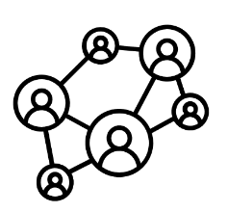
Social Norms and Influence
Social influence can be powerful drivers of behavior change
Conceptualized as the pressure perceived from important others that motivates them to conform to a behavior
These influences can be driven by social beliefs, namely about what others do (empirical expectations) or what others approve or disapprove of (normative expectations) (Bicchieri, 2006).

Slide 4
Psychosocial Determinants
Norm-based messaging to promote toilet use in India were primarily guided by Community Led Total Sanitation (CLTS), the Risks, Attitudes, Norms, Abilities, and Self-regulation (RANAS) approach, Behavior Centric Design (BCD)
CLTS aims to create a new norm by creating normative expectations
Previous studies did not assess the conditionality of toilet usage on social expectations or the role of social networks in forming expectations

Slide 5
Descriptive vs. Social Norms
A descriptive norm is a:
pattern of behavior, such that
individuals prefer to conform to it
on condition that they believe that
most people in their reference network
Conform to it [empirical expectations]
A social norm is a:
rule of behavior, such that
individuals prefer to conform to it
on condition that they believe that most people in their reference network
Conform to it [empirical expectations]
Believe they ought to conform to it [normative expectations]

Slide 6
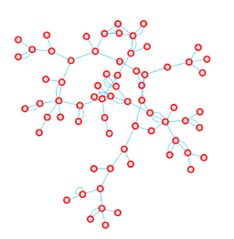
Norms are Properties of Social Networks
Individuals are more sensitive to empirical and normative expectations about their relatives and friends.
The spread of information about toilet use through social networks can be an important factor of behavior change.
Another strategy is to create new networks: connecting individuals who were previously not connected (through community events)

Slide 7
LENNS Overview
Preliminary Research Phase
Sept. - Oct. 2017
LENNS network survey
April – July 2018
LENNS norms survey
Focus group discussion
Sept. - Oct. 2017
Analysis of formative research data
Aug. – Sept. 2018

Slide 8
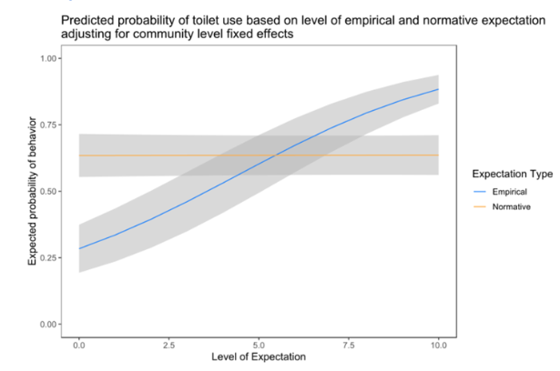
Assessing Conditionality
Test 1: Regression Analyses
Regress the respondents’ behavior on their own social expectations. Controls for factors that may affect behavior but do not influence conditionality, such as personal normative beliefs and community-specific fixed-effects.
Empirical expectations predict behavior (even when false) but normative expectations do not.
C. Bicchieri

Slide 9
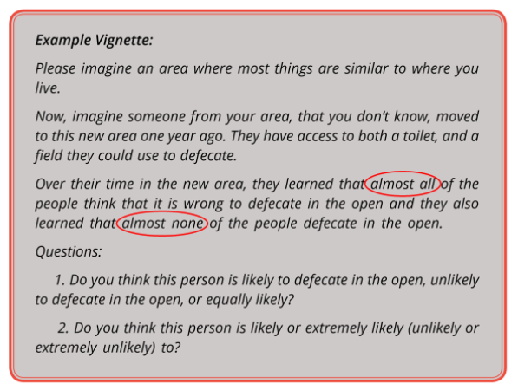
Assessing Conditionality
Test 2: Vignettes
Those exposed to vignettes with low empirical expectations predicted less latrine use.
Varying normative expectations had no such effect.
C. Bicchieri

Slide 10
Diagnosis
There is a descriptive norm of toilet use in the areas we sampled.
Though a social norm may emerge if a sufficiently high number of people construct toilets.
Experimental research has shown that people infer normative information from empirical data - but not the other way around.
By targeting behavior through empirical information, one may indirectly strengthen normative expectations.
It is costly to create a social norm. Could it be cheaper to create one by first strengthening an existing descriptive norm?

Slide 11
Two Avenues for Intervention
Option #1: Create a new social norm or enhance conditionality of the collective behavior on normative expectations
Example: Community-led total sanitation (CLTS) programming
Programs/ Interventions that incorporate injunctive messaging
Option #2: Use conditionality on empirical expectations as a collective behavior change strategy for sanitation programming
Possibly more cost-effective approach
Our LENNS intervention employs this behavior change strategy
Are these two avenues completely distinct? Evidence suggests they are not
Normative expectations may be inferred from empirical expectations (i.e., spillover effects)

Slide 12
Option #1
Create a new social norm or strengthen the conditionality of target behavior on normative expectations
Build/enhance conditionality by incorporating program elements that demonstrate the negative externalities of present behavior
Leverage as rationale for why others in community have legitimate right to insist that others do not engage in present behavior
Facilitate negative sanctions for people who deviate

Slide 13
Option #2
Use conditionality on empirical expectations as a collective behavior change strategy for sanitation programming
Convince people that more of their community actually use sanitation facilities
Convince people that more of their community intend to use sanitation facilities
This descriptive information will facilitate the fulfillment and stabilization of the seeded expectation

Slide 14
Implications for Program Design
Programs should first diagnose collective behaviors
Program implementers should acknowledge the role socially conditional preferences can play in supporting or preventing target behaviors
Intervention content, techniques, and implementation approaches should be designed in accordance with the results of the collective behavior diagnosis (for instance, descriptive or social norms)

Slide 15
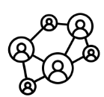
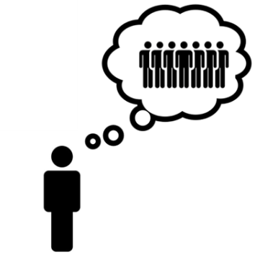
LENNS Behavior Change Focus

Slide 16
LENNS Overview
Preliminary Research Phase
Intervention Conception Phase
Sept. - Oct. 2017
LENNS network survey
April – July 2018
LENNS norms survey
Oct. 2018
Synthesis of formative research findings
Dec. 2018 – Jan. 2019
Intervention mapping
Focus group discussion
Sept. - Oct. 2017
Analysis of formative research data
Aug. – Sept. 2018
Problem & solution tree development
Oct. – Nov. 2018
Trials of improved practices (TIPS)
Fall 2019

Slide 17
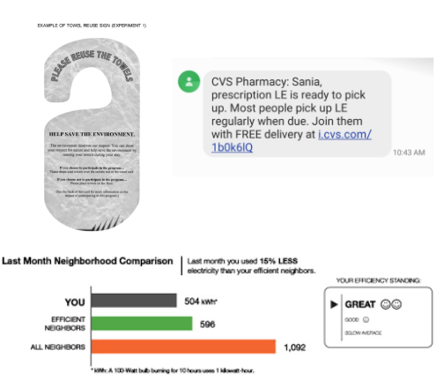
Descriptive Norms
Dissemination of descriptive norms/ social information
Reflects a strategy that is novel to the sanitation sector, yet has been effective in changing a variety of behaviors, such as water use, drinking behavior, energy consumption
Ayres, I., et al..“Evidence from Two Large Field Experiments that Peer Comparison Feedback Can Reduce Residential Energy Usage,” J. Law, Econ. Organ., 2013, 29(5), 992-1022
Neighbors, C., et. al.“Targeting misperceptions of descriptive drinking norms: Efficacy of a computer-delivered personalized normative feedback intervention,” J. Consult. Clin. Psychol., 2004, 72(3):434-47
Ferraro, P. J., et.al.“The persistence of treatment effects with norm-based policy instruments: Evidence from a randomized environmental policy experiment,” in American Economic Review, 2011, vol. 101, no. 3, pp. 318–322

Slide 18
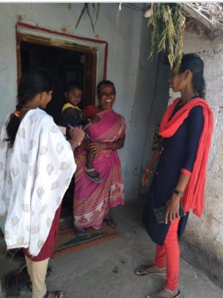
Descriptive Norm Messaging (DNM)
How does DNM work?
The message is framed to shift one’s empirical expectation to drive behavior change to the desired direction
Research also support that descriptive norm messages are more effective through providing interpersonal interactions than broadcasting
Real K., Rimal, R. N. “Friends talk to friends about drinking: Exploring the role of peer communication in the theory of normative social behavior,” Health Commun, 2007;22(2

Slide 19
Constructing Descriptive Norm Messages
Make it context specific (peri urban wards)
Understand the reference groups for the community
Check preference and reactions to the framing of the message
Use of only positive reinforcements
Use of updated messages to keep it engaging

Slide 20
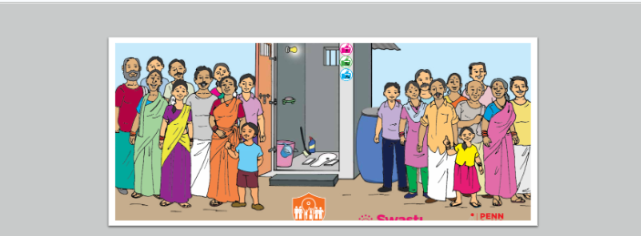
Insights Designing Norm Messages
Strike a balance for credibility:
Pick a trusted messenger within the community
There should be congruence between the message and what people can see
Make the change visible
Stickers on households with improved sanitation
Use dynamic norm nudging. Broadcast a positive trend in the community (dynamic messaging)
Use network connections to facilitate information flow
WhatsApp groups
Testimonials

Slide 21
How did we incorporate social influence?
“Not getting left behind” in a changing community was an effective prompt
Tap into community values
Imitation of prominent community members
Pride and wellbeing of families
Affiliation to the community

Slide 22
Levels of Intervention
Household level
Acknowledgement of progress
Diffusion of information about resources
1
Group level
Peer conversations
Creation of new social networks
Use of social media groups facilitated by prominent community members
2
Ward level
Community mobilization and public commitment events
Mass audio announcements
3

Slide 23
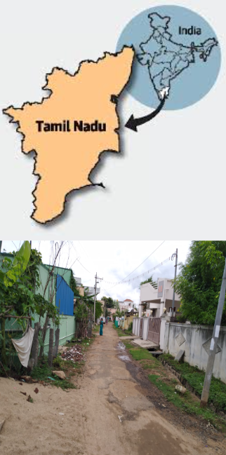
LENNS Intervention
Setting: Peri-urban Tamil Nadu
Pudukkottai and Karur districts
Design: Cluster randomized trial [ClinicalTrials.gov NCT04269824]
3 target behaviors:
Exclusive use of toilets (>5yrs)
Ownership of toilet
Cleaning/maintenance of toilets

Slide 24
LENNS Overview
Preliminary Research Phase
Intervention Conception Phase
RCT Phase
Sept. - Oct. 2017
LENNS network survey
April – July 2018
LENNS norms survey
Oct. 2018
Synthesis of formative research findings
Dec. 2018 – Jan. 2019
Intervention mapping
Jan 2020
LENNS baseline
Jan 2021 (now June)
LENNS endline
Focus group discussion
Sept. - Oct. 2017
Analysis of formative research data
Aug. – Sept. 2018
Problem & solution tree development
Oct. – Nov. 2018
Trials of improved practices (TIPS)
Fall 2019
LENNS intervention implementation
12 months

Slide 25
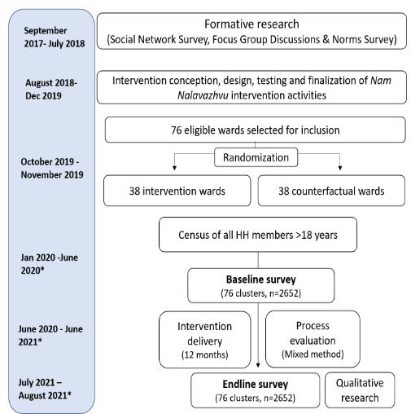
LENNS Overview (Continued)

Slide 26
Insights from Cluster Randomized Trial to Improve Toilet Usage in Peri-urban Tamil Nadu, 2020-2021
The Longitudinal Evaluation of Networks and Norms Study (LENNS)

Slide 27
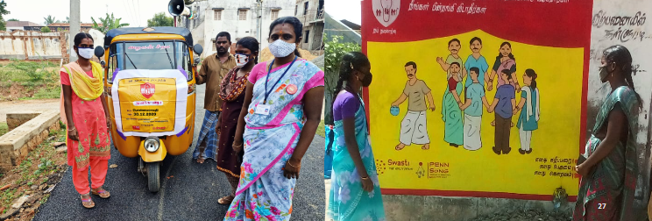
Community Interventions
Community Mobilization and Commitment Events
Audio announcements
Wall paintings

Slide 28
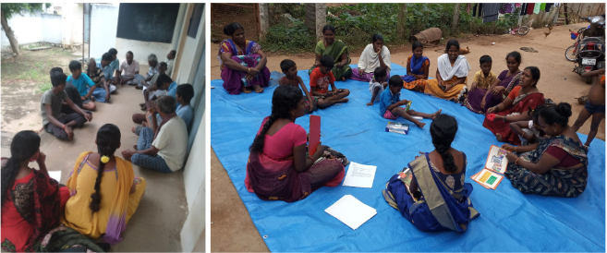
Group Interventions: Peer Learning Sessions and WhatsApp Groups
Creating new social networks

Slide 29
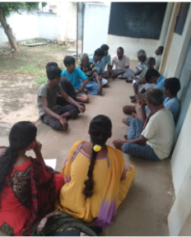
Peer Learning Sessions
Increased access to role models from one’s community
Emotional support from others who have gone through the process to build toilets
Engaging facilitated discussions to increase network access and plan to achieve or sustain sanitation behaviors
“Seeing others talk about their or their neighbors’ toilet construction also motivated them to use their savings to build a toilet. There was a shift in perception of toilet as a “necessity” to toilet as a “basic necessity.” - Outreach Worker, Karur

Slide 30
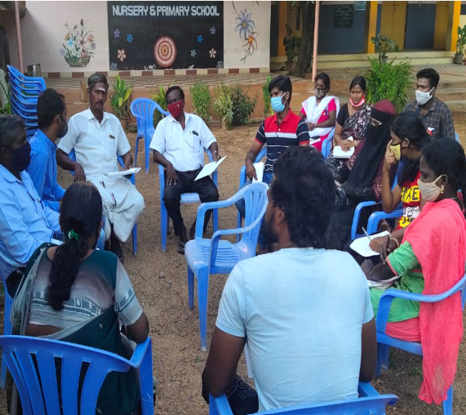
Social Advocates
Identifying social influencers from the community (animators, youth clubs, Lions club)
Use of non-monetary incentives
‘Feel good’ to help one’s community
Support own community
Recognition from TP officials
Some continue to work even after project end date

Slide 31
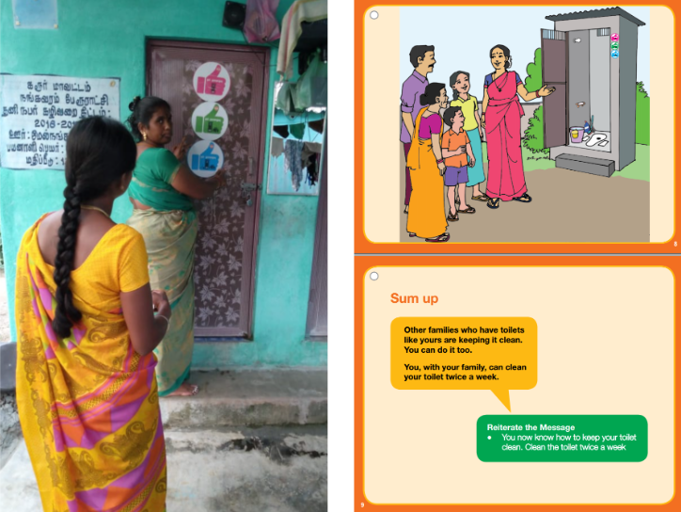
Household Interventions
IPC tools- Flipbook, Dialogue cards
Stickers
Goal monitoring cards

Slide 32
Results from the Community Randomized Trial of LENNS (2020-2021)
The Longitudinal Evaluation of Networks and Norms Study (LENNS)

Slide 33
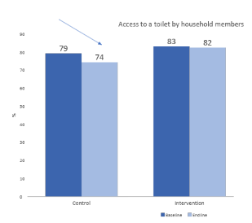
Differential Decrease in Toilet Access during 2020-2021 Pandemic
4.2% point net difference between intervention and control

Slide 34
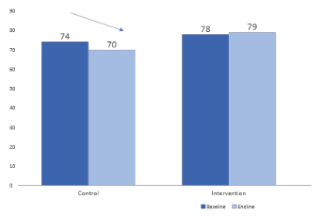
Reported Use of Toilet for Last Defecation Increased Due to Intervention in 2021
5.2% point net difference

Slide 35
What does this mean?
More people use the toilet they have access to because of the pandemic.
94% vs. 84% reported exclusively using a toilet

Slide 36
The Cause: Change in Empirical Expectations (EE)
Out of 10 people in your ward, how many do you think own a toilet?
Mean difference (SD): +0.7 (0.2)*
I believe more people in my ward are constructing a toilet compared to 6 months ago.
Mean difference (SD): +12% points (0.04)* more likely
I believe more people in my ward use a toilet compared to 6 months ago.
Mean difference (SD): +11% points (0.03)* more likely

Slide 37
The Role of Normative Expectations (NE)
There was no causal role for Normative Expectations. With time, stable Empirical Expectations lead to new Normative Expectations.
Out of 10 people in your ward, how many believe one should use a toilet?
Mean difference (SD): +0.6 (0.2)*
I believe more people in my ward think one should use a toilet.
No difference across arms
Ref: C. Bicchieri and J. Kuang (2023) From is to ought and back: Variability and asymmetry in social inferences from norm information, CSNBD, 2023

Slide 38
Was the EE-centric Strategy Successful?
Between the intervention and control, we see:
4% net increase in toilet access
5% net increase in reported toilet use
Shifts in social beliefs
Empirical Expectations of toilet ownership and use increased.
Normative Expectations also increased slightly and we expect it to increase substantially with stable behavior over time.

Slide 39
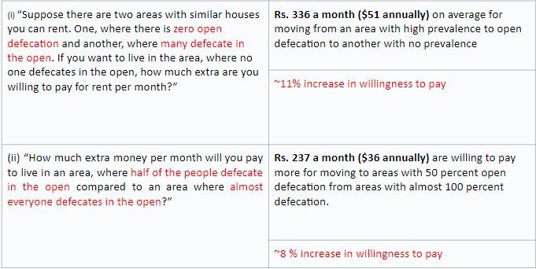
Finding: More people were willing to pay to live in non-OD areas in intervention arms

Slide 40
What did we learn from the process evaluation of a behavioral intervention during the COVID-19 pandemic?
The Longitudinal Evaluation of Networks and Norms Study (LENNS)
Notes:
Hi all, we’re very sorry – we have reached our maximum number of participants on Zoom. Please follow the talk on our Facebook page: https://www.facebook.com/penncsnb
Please post any questions on the Facebook comments!
We’re LIVE on NoBeC Talks discussing Widespread misperceptions of long-term attitude change. Watch what’s happening here:

Slide 41
Context of Intervention Delivery
Unique COVID-19 pandemic setting (2019-2020)
Reduced community interactions and gatherings (smaller groups in public spaces)
Heightened risk perception
Less motivated to build toilets due to financial constraints (loss of work)
We modified our intervention activities to maximize impact
Changed community mobilization meeting to small group meetings at the neighborhood level for peer learning sessions discussions
Shared content through community leaders on social media and WhatsApp groups

Slide 42
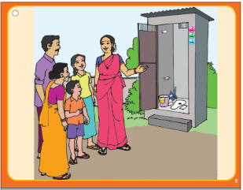
Qualitative Insights from Intervention Recipients
“There was a major difference in the response of the community members at the beginning and towards the middle of intervention. The acceptance and trust were much less early, however later [after repeated visits] the community members exuded love like towards a family member.”
Outreach Worker-Pudukkottai
“ More people around us are using a toilet. We have also started using a toilet as it will protect us from diseases and will also protect the environment to keep us free of illness”.
Respondent, Karur

Slide 43
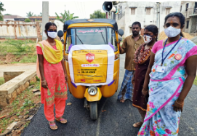
Qualitative Insights from Intervention Recipients
“I am helping LENNS because it gives me personal satisfaction and a sense of pride to contribute to my community.”
Advocate - Karur
“A person in our community did to have resources to build a toilet, we crowdsourced money from the ward members, and helped him get a toilet.”
Advocate – Pudukkottai

Slide 44
Lessons from LENNS Intervention Delivery
Modification of behavioural interventions are inevitable (health, environmental, political crises) Need to be documented to inform future interventions and plans
Important to assess and address contextual factors and its potential influence on the target population
Intervention strategy design and outreach workers should be assigned according to the needs of the target population
Messengers must be trusted to spread the norm
Community influencers are powerful medium: appropriate incentives and engagement strategy required

Slide 45
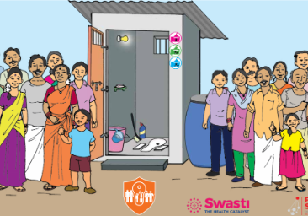
LENNS Policy and Implementation Implications
Community-led Norm Change Works.
Improving access to water, sanitation and hygiene, promoting norms in favour of toilet use, and operations and management as a continuum may prove to be a sustainable way forward for Tamil Nadu

Slide 46
Examples of Publications
The Longitudinal Evaluation of Networks and Norms Study (LENNS)
Notes:
Hi all, we’re very sorry – we have reached our maximum number of participants on Zoom. Please follow the talk on our Facebook page: https://www.facebook.com/penncsnb
Please post any questions on the Facebook comments!
We’re LIVE on NoBeC Talks discussing Widespread misperceptions of long-term attitude change. Watch what’s happening here:

Slide 47
Toilet Usage and Formative Research
Thulin, Erik, Alex Shpenev, Sania Ashraf, Upasak Das, Jinyi Kuang, and Cristina Bicchieri. "Toilet Use Is a Descriptive Norm: The Influence of Social Expectations on Toilet Use in Bihar and Tamil Nadu, India." India (October 2021) (2021).
Bicchieri C, Ashraf S, Das U, Delea MG, Kohler HP, Kuang J, et al. Phase 2 project report. Social networks and norms: sanitation in Bihar and Tamil Nadu, India. Center for Social Norms and Behavioral Dynamics. Philadelphia; 2018. URL: https://repository.upenn.edu/pennsong/17/ [accessed 2019-12-07]
Norms during the COVID-19 Pandemic
Ashraf, Sania, Jinyi Kuang, Upasak Das, and Cristina Bicchieri. "Sanitation practices during early phases of COVID-19 lockdown in peri-urban communities in Tamil Nadu, India." The American journal of tropical medicine and hygiene 103, no. 5 (2020): 2012.
Kuang, Jinyi, Sania Ashraf, Upasak Das, and Cristina Bicchieri. "Awareness, risk perception, and stress during the COVID-19 pandemic in communities of Tamil Nadu, India." International journal of environmental research and public health 17, no. 19 (2020): 7177.
Notes:
Hi all, we’re very sorry – we have reached our maximum number of participants on Zoom. Please follow the talk on our Facebook page: https://www.facebook.com/penncsnb
Please post any questions on the Facebook comments!
We’re LIVE on NoBeC Talks discussing Widespread misperceptions of long-term attitude change. Watch what’s happening here:

Slide 48
Gender Norms in Sanitation Decision-making and Toilet Usage
Das, Upasak, Jinyi Kuang, Sania Ashraf, Alex Shpenev, and Cristina Bicchieri. "Women as pioneers: Examining their role in decision making on toilet construction in India." Journal of Human Development and Capabilities 24, no. 1 (2023): 70-97.
Babbar, Karan, Upasak Das, Sania Ashraf, Alex Shpenev, and Cristina Bicchieri. "Unlocking the Role of social norms: How they shape women’s public toilet usage in India." The American Journal of Tropical Medicine and Hygiene 109, no. 5 (2023): 1177.
Ashraf, Sania, Jinyi Kuang, Upasak Das, Alex Shpenev, Erik Thulin, and Cristina Bicchieri. "Social beliefs and women’s role in sanitation decision making in Bihar, India: An exploratory mixed method study." Plos one 17, no. 1 (2022): e0262643.
Kuang, Jinyi, Sania Ashraf, Alex Shpenev, Maryann Greene Delea, Upasak Das, and Cristina Bicchieri. "Women are more likely to expect social sanctions for open defecation: Evidence from Tamil Nadu India." Plos one 15, no. 10 (2020): e0240477.
Notes:
Hi all, we’re very sorry – we have reached our maximum number of participants on Zoom. Please follow the talk on our Facebook page: https://www.facebook.com/penncsnb
Please post any questions on the Facebook comments!
We’re LIVE on NoBeC Talks discussing Widespread misperceptions of long-term attitude change. Watch what’s happening here:

Slide 49
LENNS Team
University of Pennsylvania
Cristina Bicchieri (Principal Investigator)
Sania Ashraf, PhD
Upasak Das, PhD
Kavita Chauhan, PhD
Alex Shpenev, PhD
SWASTI
K. Jeyaganesh
Rajesh Kanna
Johnson Thangaraj
Lurdraj S.
Yuvraj Y.
N. Raghunathan
Siddhi Mankad
P. Rajarethinam
Abraham

Slide 50
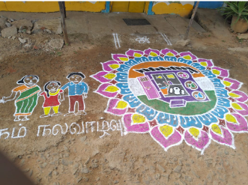
Questions and Comments

Slide 51
Additional Slides

Slide 52
How did LENNS Work?
Toilet use improved
Awareness of how to access resources to build toilets improved
Higher demand for toilets reported
69% (5283) HHs owned toilets at baseline
We leveraged
them as influencers
45% of target households were influenced
to build toilets
11% (259) built toilets and 915 committed to build one

Slide 53
Mechanism: Social Expectations
Empirical expectations:
(i) “Out of ten members in your ward, how many do you think use a toilet every time they need to defecate?”
(ii) “Out of ten households in your ward, how many do you think own a toilet at home?”
(iii) “Many people in my ward built new toilets in the past six months”
(iv) “I think more people expect others to use toilets compared to six months ago”
Normative expectations:
(i) “Out of ten members of your ward, how many do you think believe one should use a toilet to defecate?”

Slide 54
Pre-Intervention Balance: Treated and Control Areas
 | Control |  | Treatment
Variable | N | Mean | N | Mean | Difference
Age | 1280 | 44.894 | 1291 | 44.967 | -0.073
Female | 1280 | 0.536 | 1291 | 0.508 | 0.028
Years of schooling | 1280 | 7.908 | 1291 | 7.954 | -0.046
Currently married | 1280 | 0.709 | 1291 | 0.726 | -0.016
Upper caste | 1278 | 0.112 | 1290 | 0.129 | -0.018
Household size | 1280 | 3.623 | 1291 | 3.577 | 0.046
Owns color TV | 1280 | 0.928 | 1291 | 0.920 | 0.008
Owns computer | 1280 | 0.066 | 1290 | 0.095 | -0.028
Uses internet | 1279 | 0.460 | 1289 | 0.476 | -0.017
Uses LPG as cooking medium | 1280 | 0.760 | 1291 | 0.813 | -0.053***
Has separate kitchen | 1280 | 0.738 | 1291 | 0.761 | -0.022
Works as casual laborer | 1280 | 0.200 | 1291 | 0.209 | -0.009

Slide 55
Outcome Variables
 | Control |  | Treatment
Variable | N | Mean | N | Variable | Difference
Access to toilets | 1280 | 0.791 | 1290 | 0.833 | -0.041
Using toilets last time for defecation | 1280 | 0.741 | 1291 | 0.779 | -0.039
Primary defecation place last two days: toilets | 1280 | 0.737 | 1291 | 0.772 | -0.036
Exclusive toilet usage in last two days | 1280 | 0.665 | 1291 | 0.706 | -0.042
Exclusive toilet usage in last seven days | 1280 | 0.657 | 1291 | 0.702 | -0.045
Higher proportion in the treatment arm had access and used a toilet (difference not significant)

Slide 56
Effect of LENNS Treatment
 | (1) | (2) | (3) | (4) | (5)
 | Access to toilets | Using toilets last time for defecation | Primary defecation place last two days: toilets | Exclusive toilet usage in last two days | Exclusive toilet usage in last seven days
Treated wards | 0.098** | 0.075** | 0.076*** | 0.075** | 0.082***
 | (0.041) | (0.029) | (0.028) | (0.029) | (0.028)
Observations | 2,562 | 2,562 | 2,562 | 2,562 | 2,562
Full sample (endline survey).
Controls for the age, sex, caste group, household size and asset posession PCA index along with town panchayat dummies.
About 6-10% point increase in access to toilets.
About 7-8% point increase in toilet usage led by LENNS intervention.

Slide 57
Threats to Identification
Despite running a randomised trial, there were a threats to randomization because of prevailing conditions:
CAA/NRC protest
COVID effects
27% attrition
A number of robustness checks ensure that the findings are robust. LENNS has been successful in increase toilet usage and access.

Slide 58
Impact of LENNS on Empirical Expectations and Normative Expectations
 | Empirical expectations |  |  |  | Normative expectations
 | How many out of 10 use a toilet to defecate? | How many out of 10 own a toilet? | Many people are constructing a toilet | Many people are using a toilet | How many out of 10 think one should use a toilet to defecate?
Treatment | -0.032 | 0.801*** | 0.106*** | 0.096*** | 0.620***
 | (0.288) | (0.218) | (0.037) | (0.036) | (0.256)
All controls | Yes | Yes | Yes | Yes | Yes
Town Panchayat FE | Yes | Yes | Yes | Yes | Yes
Observations | 1,852 | 1,852 | 1,852 | 1,852 | 1,852
Both EE and NE increased through LENNS intervention.

Slide 59
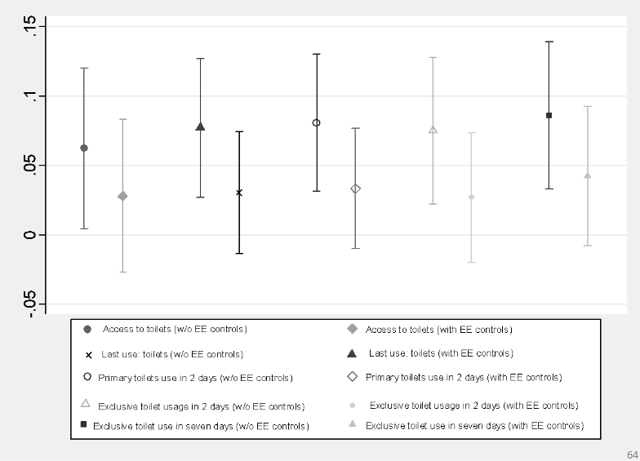
Role of Empirical Expectations

Slide 60
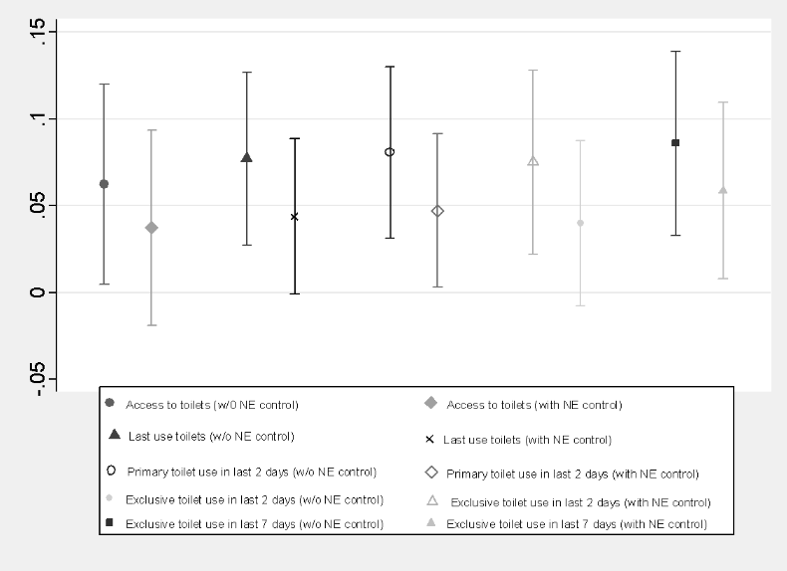
Role of Normative Expectations
Both EE and NE played a role in increasing toilet access and usage. EE appears to have higher mediating effect than NE.

Slide 61
Key Findings
•LENNS has been successful in increase toilet usage and access
•Increasing EE and NE through LENNS played a key role in improving toilet access and usage.
•However, among the two, EE appears to have a higher mediating effect than NE.

Slide 62
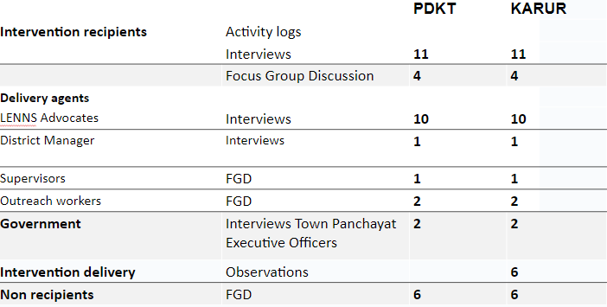
Data Source

